Slide 1
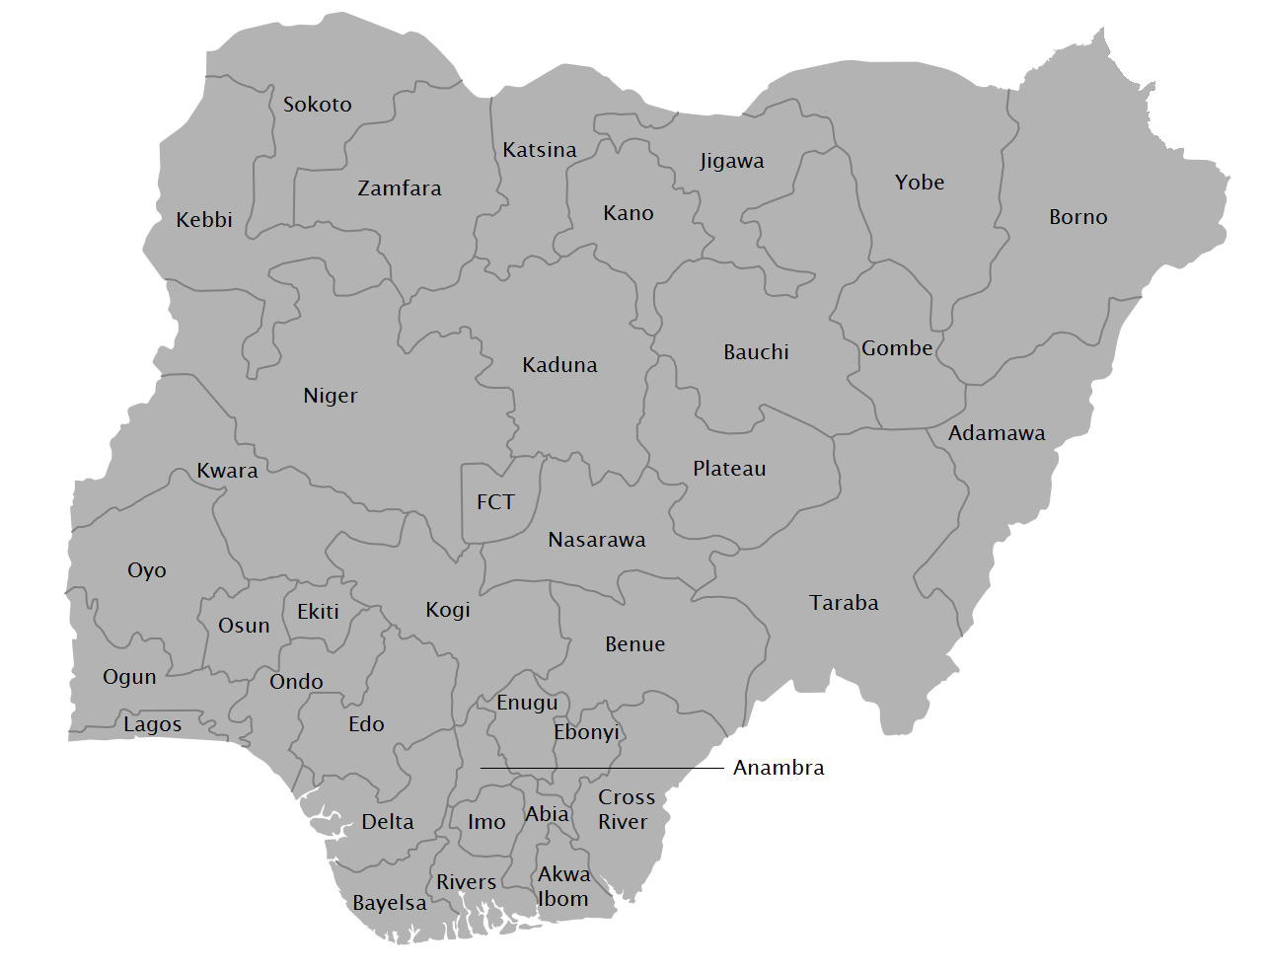
NIGERIA TERRORISM AND SECURITY INCIDENTS REPORT Data-Driven Insights into Terrorism Incidents, Fatalities, and Regional Patterns Emmanuel Chinonso Nwala Data Analyst Portfolio Project | Year of Analysis (2020–2025)

Slide 2
Project Overview
Context
Nigeria has experienced fluctuating security challenges over the past decade, driven by insurgency, armed banditry, communal conflicts, and criminal activities. Understanding the patterns behind these incidents is critical for strategic intervention and resource allocation.
Objective
This analysis examines security incidents across Nigeria over multiple years, with the goal of:
Understanding how security incidents are evolving over time
Identifying geographic hotspots
Uncovering key perpetrators driving insecurity
Understanding the hidden motive or agenda behind the insurgency
Supporting data-driven security planning and intervention

Slide 3
DATASET OVERVIEW
Time Period: 2020 – 2025
Metrics analyzed:
• Total Incidents • Fatalities • Kidnapping cases • Perpetrator groups • Regional distribution • State-level impact
Tools Used
• Microsoft Power BI • Microsoft Excel • SQL

Slide 4
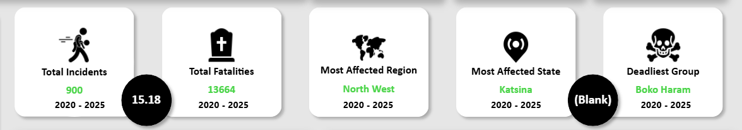
KEY METRICS OVERVIEW
Key findings:
• 900 security incidents recorded • 13,664 total fatalities • North West most affected region • Katsina most affected state • Boko Haram identified as deadliest group

Slide 5
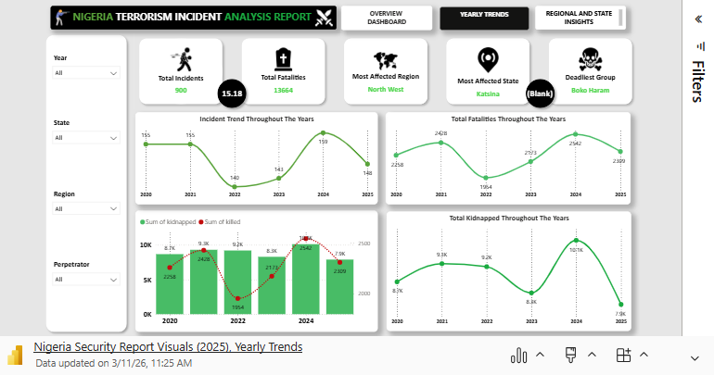
YEARLY TRENDS
Insights
• Security incidents declined in 2022, then rose again in 2024 • Fatalities follow a similar trend pattern • Kidnapping incidents increased significantly in recent years
Key Interpretation
This suggests a shift toward economically motivated violence, especially kidnapping activities.

Slide 6
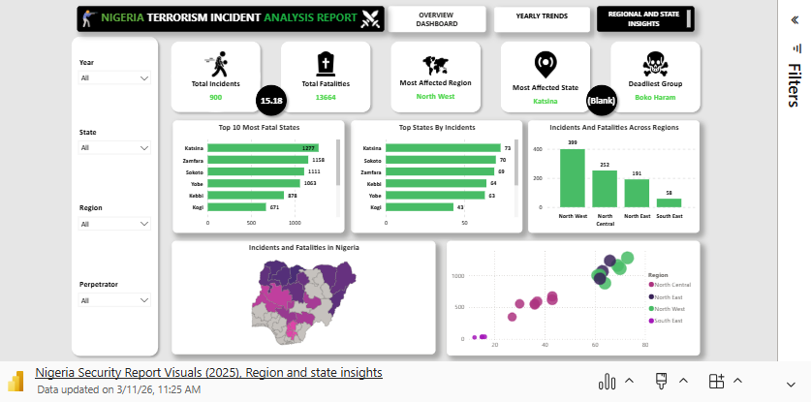
REGIONAL & STATE INSIGHTS
Key Insights
• Violence is heavily concentrated in Northern Nigeria
Top affected states:
• Katsina • Zamfara • Sokoto • Yobe
Key Interpretation
Security threats are geographically concentrated rather than nationwide.

Slide 7
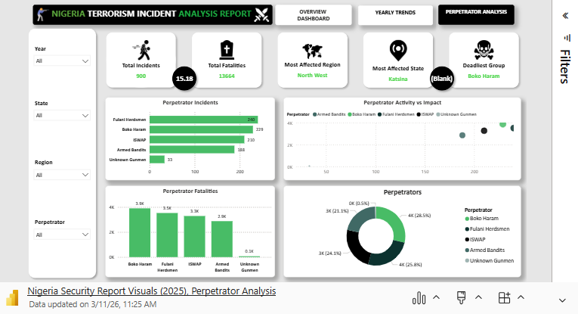
PERPETRATOR ANALYSIS
Who is driving the incidents?
Boko Haram
Armed Bandits
Fulani Herdsmen
ISWAP
Unknown / Unidentified
Key Insights
Nigeria’s insecurity is mainly caused by a few repeat groups like Boko Haram, Armed Bandits, Fulani Militants, and ISWAP. At the same time, many incidents are blamed on unknown gunmen, showing that intelligence and tracking remain difficult. Because the problem is concentrated among specific groups, focused intelligence-driven actions (like creating more military bases in the affected regions) would work better than broad, general security measures.

Slide 8
RECOMMENDATIONS FOR DECISION-MAKERS
Based on the analysis:
Resources should be prioritized toward high-impact states
Creating of more military bases in these affected regions to help combat the insurgents
Improved perpetrator identification would significantly enhance response strategies
Targeted deployment in high-burden northern states
Strengthened community policing and intelligence systems
Disruption of kidnapping and criminal financing networks
Improved data attribution and inter-security agency (like the armed forces, DSS and para-military) coordination

Slide 9

Final Executive Insight
This analysis examined terrorism and violent security incidents across Nigeria, identifying geographic concentration, perpetrator patterns, incident trends, and fatality distribution. The findings reveal a highly concentrated security burden, rather than a uniformly distributed national crisis.
The North West emerges as the most affected region, with states such as Katsina, Zamfara, and Sokoto consistently ranking highest in both incidents and fatalities. Fatality patterns closely mirror incident concentration, indicating not only frequent attacks but high lethality in key hotspot states.
Perpetrator analysis shows that a small number of identifiable armed groups (4) are responsible for the majority of recorded incidents. A notable surge in kidnapping-related activities in recent years suggests an increasing economic dimension to insecurity, where criminal violence is driven not only by ideology but by financial incentives.
Nigeria’s security crisis is not merely a military challenge -- it is a data, ideologic, economic, and governance challenge. Sustainable improvement will require smarter allocation of limited resources, deeper community engagement and policing, improved intelligence systems, expansion or creating more military bases and targeted socioeconomic intervention in the most affected regions.
A focused, intentional and evidence-driven approach by the security agents including the whole country’s security architecture — rather than broad reactive deployment — offers the strongest path toward measurable and sustainable national stability.
CONCLUSION

Slide 10
Thank You
Emmanuel Chinonso Data Analysts
Nigeria Security Insurgency Analysis
March, 2026

